Slide 1
Function inputs
Parameters and arguments

Slide 2
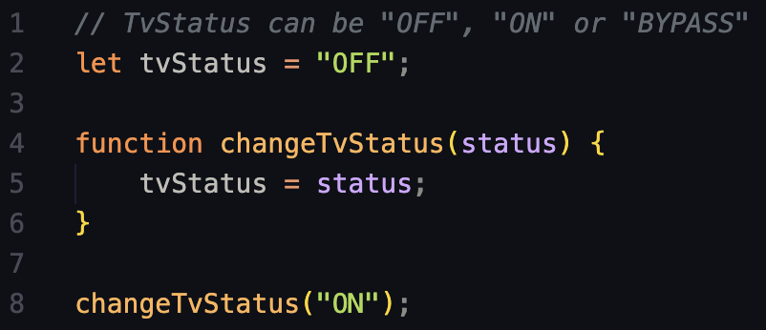
Re-use functions
What if instead of having 2 functions we could just use 1 to change the TV status?

Slide 3
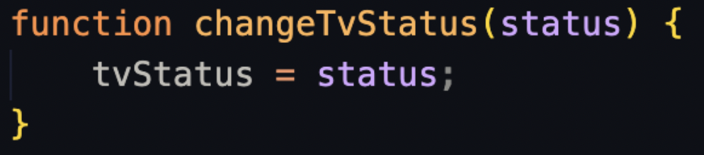
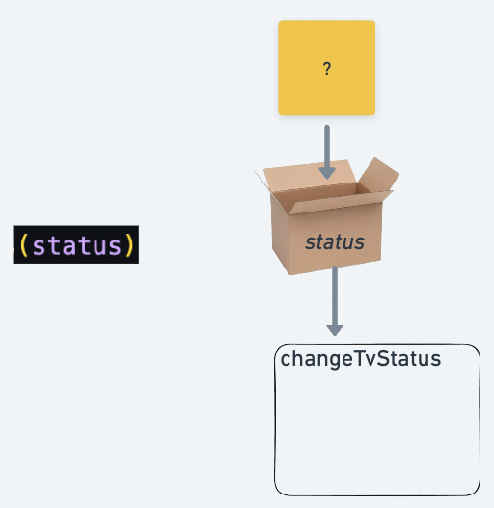

What is an input parameter?
We can think of it as a variable
that will take a different value every time the function is called.
It can only be used inside the function body.

Slide 4
How does this code work?
Let’s read it like the computer does.

Slide 5
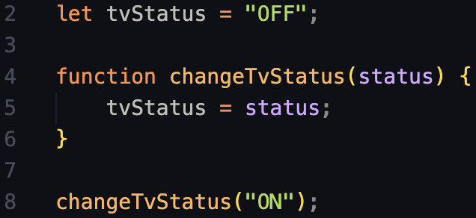

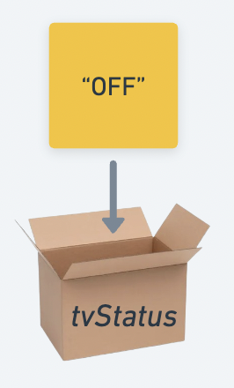
Variable declaration
We declare a variable named ‘tvStatus’ and assign it the string “OFF” as a value

Slide 6
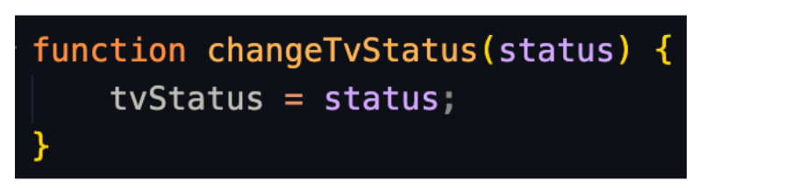
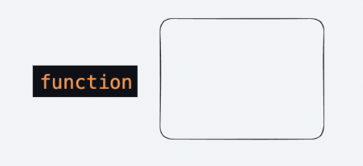

Function declaration
We start building a function with the keyword “function”

Slide 7
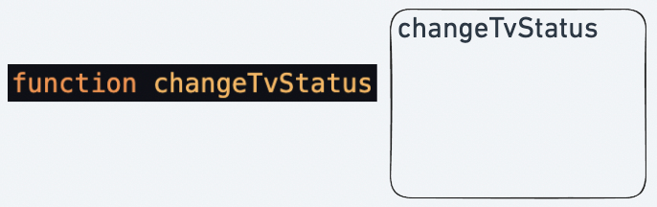
Function declaration
We give the function a name to be used later.

Slide 8
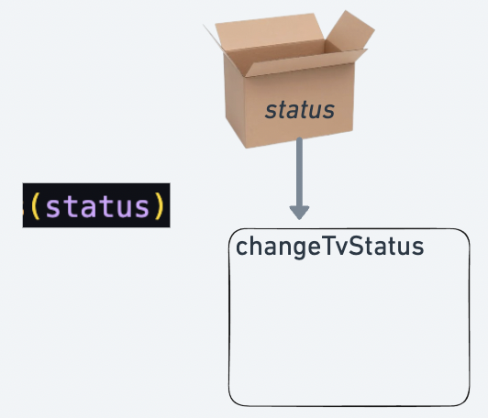
Function declaration
We define that the function will take 1 input parameter, named “status”

Slide 9
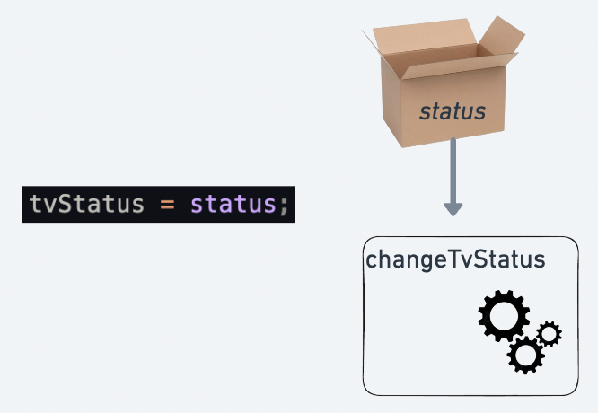
Function declaration
We define the function “body”. Remember it won’t run now.
It will only run once we “call” the function.

Slide 10

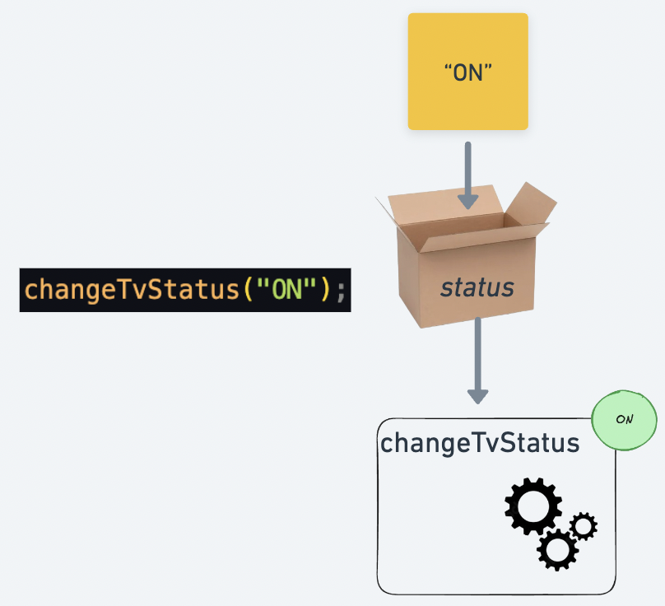
Function call
We “call” the function.
We pass the string “ON” as an argument.
The parameter “status” will now take that value.

Slide 11
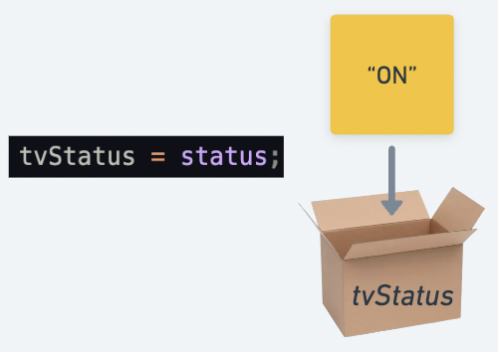
Function call
The body of the function runs.
The parameter status has now the value of “ON”, which gets saved to the variable tvStatus.

Slide 12
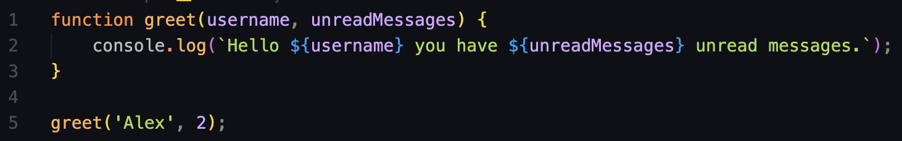
More than 1 parameter?

